Slide 1
project display
<h1> AZIZ RIDANE </h1>

Slide 2
Why i chose web devloppment?
<doctype html>
<body>
<header>
when i was young i always want to discover about technology i want to earn some skills that make me change the world and make people all over the world know me , from the beginning i start to learn about
five m devloppment its seveur for playing role play gta 5 then i heard something about web devloppment and with some resarch i dicover gomycode , with help from my instructor i earn skillis
</header>

Slide 3
How i create my first website?
<main>
With some resarch i find that u can create slides button with html and make it work with js then put image with css and html
And for the page of news i find a card in freefrontend (https://freefrontend.com/) and with a lots of work (5days) i make it look intreactive using css and js
</main>
<footer>
And i make button in the navbar that take u to my facebook and i put my location from googel map
(we learn it from our intructor and in the course)
and for the form, i search and i created with html and desing it with css and make alert box with js and the other alert
u can visit my link from here(https://istore1.netlify.app/index.html?fbclid=IwAR1n5kDJ2kQaIpxKuKxf455Mm228pj-Hwcnow3vOn8xjYgFebUm9wabrPjc)
</footer>
</body>
</html>

Slide 4
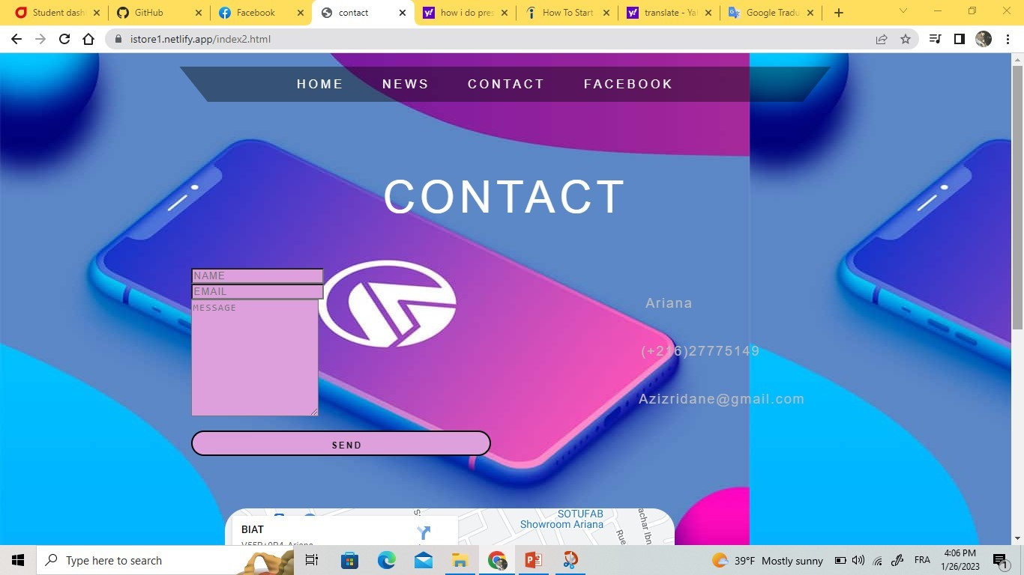
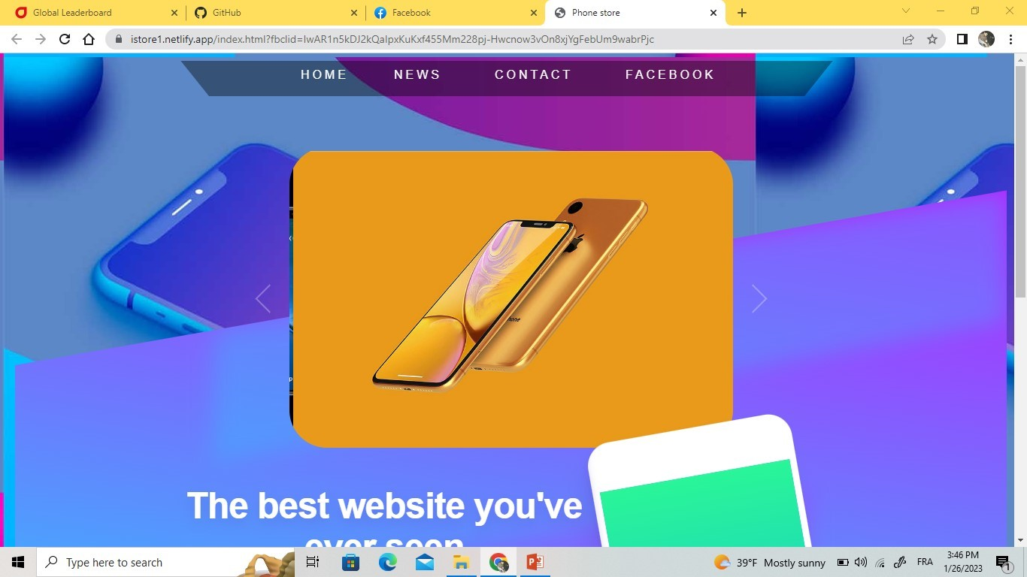
home page i use a simpel navbar with transparent background for better looking of the background ofwebiste. Then a carrousel with js for a normal home page and for the contact page i add button with html and make alert msg with js

Slide 5



What we learn?
HTML is a HyperText Markup Language file format used as the basis of a web page. HTML is a file extension that is used interchangeably with HTM. HTML consists of tags surrounded by angle brackets. HTML tags can be used to define interactive headings, paragraphs, lists, links,
What is CSS used for?
Cascading Style Sheets ( CSS) is a stylesheet language used to describe the presentation of a document written in HTML or XML (including XML dialects such as SVG, MathML or XHTML ). CSS describes how elements should be rendered on screen, on paper, in speech, or on other media.

Slide 6
javascript
JavaScript (JS) is the world’s most popular lightweight, interpreted compiled programming language. It is also known as a scripting language for web pages. It can be used for Client-side as well as Server-side developments. Internal JavaScript: We can add JS code directly to our HTML file by writing the code inside the html file or in another page name main.js
While JavaScript is influenced by Java, the syntax is more similar to C and is based on ECMAScript, a scripting language developed by Sun Microsystems.

